Slide 1
GeekOS Project 2 User process with segmentation

Slide 2
Project 2
You will add code to GeekOS to run user programs
In project 1, you run the program in kernel mode, that is unsafe.
In project 2, you make programs run at low privilege (user mode).
Reference
IA-32 Intel Architecture Software Developer’s Manual, Vol. 3
Requirements
Create user threads running executables from files in the file system.
You need to complete the segmentation table setup to support the virtual memory.

Slide 3
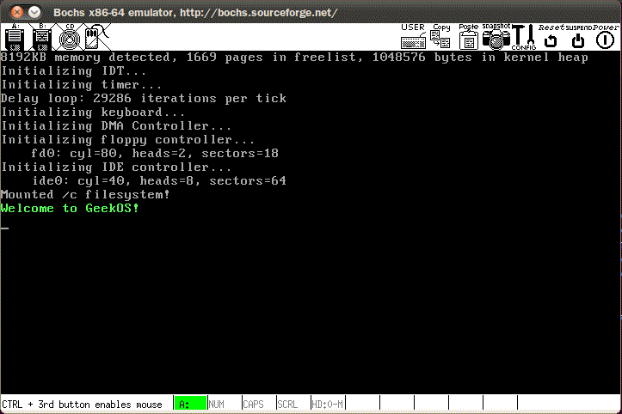
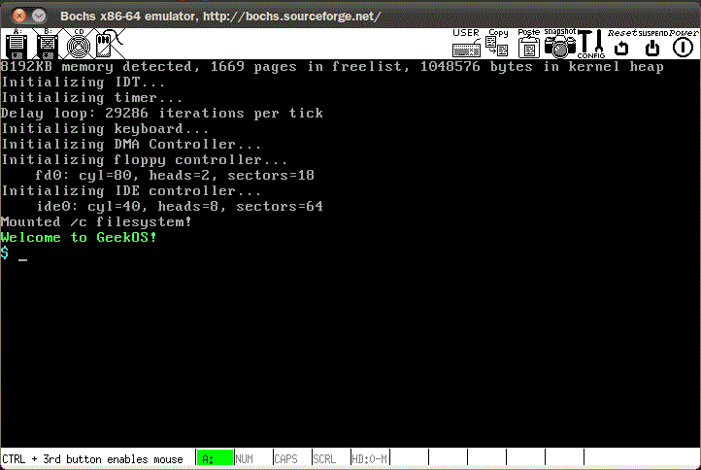
Project goal
구현결과
부팅 후 shell 정상 동작 (/c/shell.exe)
구현 시 shell이 자동으로 정상 실행
구현 전
구현 후

Slide 4
Intel IA-32 Architecture
Supports both segmentation and segmentation with paging
Each segment can be 4 GB
Up to 16 K segments per process
Divided into two partitions
First partition of up to 8 K segments are private to process (kept in local descriptor table (LDT))
Second partition of up to 8K segments shared among all processes (kept in global descriptor table (GDT))

Slide 5

Intel IA-32 Architecture (Cont.)
CPU generates logical address
Selector given to segmentation unit
Which produces linear addresses
Linear address given to paging unit
Which generates physical address in main memory
Paging units form equivalent of MMU
Pages sizes can be 4 KB or 4 MB

Slide 6
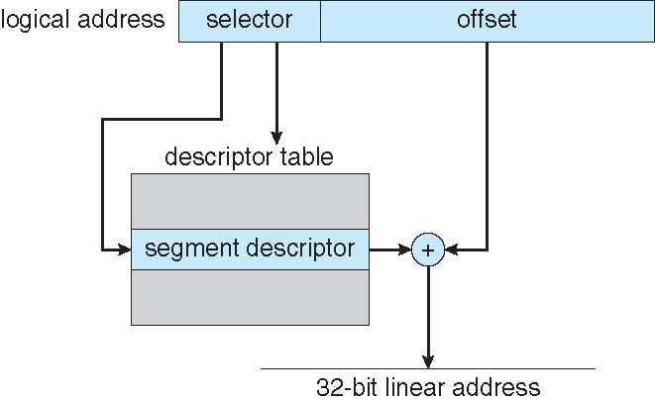
Intel IA-32 Segmentation

Slide 7
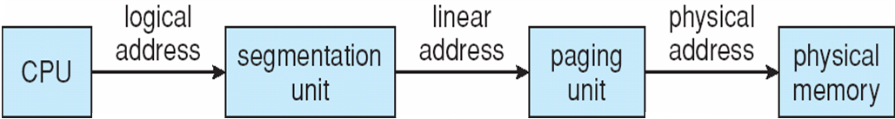
Logical to Physical Address Translation
We don’t do this here.

Slide 8
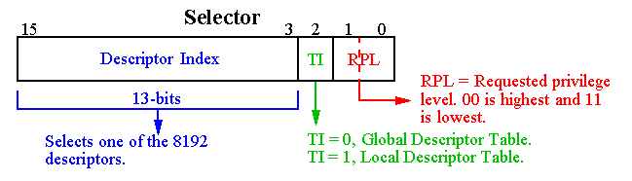
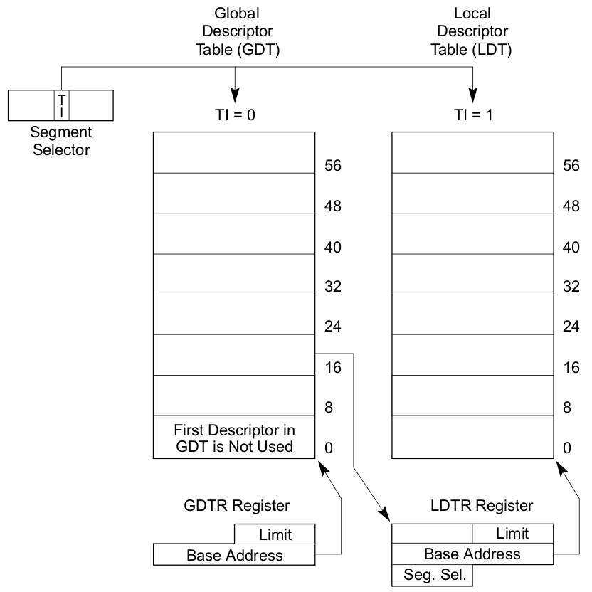
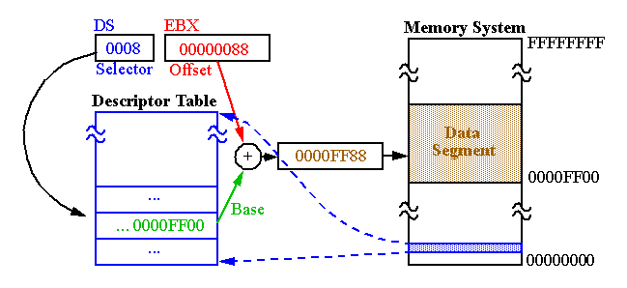
User context Descriptor Table - GDT
Descriptor Table : Segment의 정보(Base, Limit)들을 보관하고 있는 테이블
Global Descriptor Table : OS 전체에 대한 Segment Descriptor들을 보관
GDTR을 통해 접근, OS는 1개의 GDT를 가짐

Slide 9
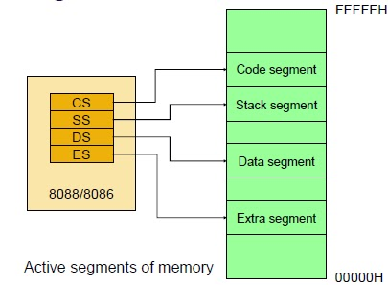
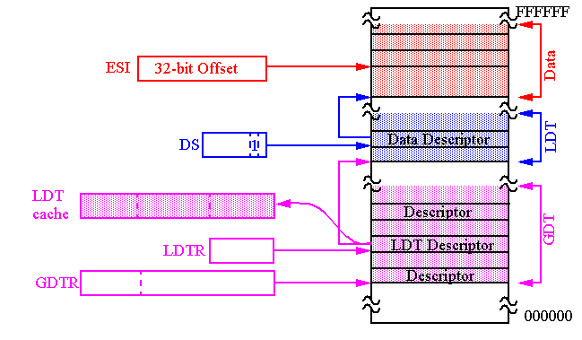
User context Descriptor Table - LDT
Local Descriptor Table : Process에 대한 Segment Descriptor들을 보관
LDTR을 통해 접근, Context Switching과 관련성이 있음
LDT의 위치를 나타내는 Segment Descriptor를 GDT 내부에 저장한 뒤, 해당 Index를 LDTR Register에 넣어주면 CPU는 LDT를 읽어 들여 Process의 Segment들에 대한 정보에 접근가능
32bit 이상의 OS에서 Segment Register에는 Segment에 관한 LDT의 Descriptor Number가 들어가게 되어 Segment Selector라는 명칭으로 바뀌게 된다

Slide 10
Segment descriptor selector
Six registers in the processor that keep track of the active segments:
CS - Code Segment
SS - Stack Segment
DS - (Default) Data Segment
ES, FS, GS - Extra Data Segments
These registers do not contain the actual segment descriptors. Instead, they contain Segment Descriptor Selectors, which are essentially the indices of descriptors within the GDT and the current LDT.
GDTR and LDTR registers
keeping track of the location of the GDT and the current LDT
The memory segments are activated by loading the address of the LDT into the LDTR and the segment selectors into the various segment registers.

Slide 11
Thread
include/geekos/kthread.h
struct Kernel_Thread {
unsigned long esp; // offset 0
volatile unsigned long numTicks; // offset 4
int priority;
DEFINE_LINK( Thread_Queue, Kernel_Thread );
void* stackPage;
struct User_Context* userContext;
struct Kernel_Thread* owner;
// helpful fields …
int pid;
// more fields …
};
This is NULL for kernel threads.

Slide 12
Implementation
GDT 초기화는 이미 구현되어 있으며, user process를 수행하기 위한 부분만 구현 필요
main.c 수정 : Spawn_Init_Process
rc = Spawn_Foreground(INIT_PROGRAM, INIT_PROGRAM, &initProcess); // uncomment
// initProcess=Start_Kernel_Thread(Spawner, 0, PRIORITY_NORMAL, true, "prj1"); // comment
Call trace
Spawn_Init_Process : main.c
calls Spawn : user.c
Read_Fully : 구현되어 있음
Parse_ELF_Executable : from Project 1
Load_User_Program : userseg.c (구현해야 함)
User_Context 생성 – Create_User_Context : userseg.c (구현해야 함)
stack size = STACK_SIZE
Start_User_Thread : kthread.c (구현되어 있음)

Slide 13
Comparison
int Spawn_Program(char *exeFileData, struct Exe_Format *exeFormat) {
…
/* Find maximum virtual address */
for (i = 0; i < exeFormat->numSegments; ++i) {
…
}
/* setup some memory space for the program */
virtSize = Round_Up_To_Page(maxva) + 4096; /* leave some slack for stack */
virtSpace = Malloc(virtSize);
memset((char *) virtSpace, '\0', virtSize);
/* Load segment data into memory */
for (i = 0; i < exeFormat->numSegments; ++i) {
….
}
/* allocate and init descriptors and selectors for code and data */
// Kernel code segment.
desc = Allocate_Segment_Descriptor();
Init_Code_Segment_Descriptor( … );
codeSelector = Selector( 0, true, Get_Descriptor_Index( desc ) );
desc = Allocate_Segment_Descriptor();
Init_Data_Segment_Descriptor(… );
dataSelector = Selector( 0, true, Get_Descriptor_Index( desc ) );
…
Free(exeFileData);
exeFileData = 0;
return 0;
}
int Load_User_Program(…) {
TODO("Find maximum virtual address");
TODO("Determine size required for argument block");
/*
* Now we can determine the size of the memory block needed
* to run the process.
*/
size = Round_Up_To_Page(maxva) + DEFAULT_USER_STACK_SIZE;
argBlockAddr = size;
size += argBlockSize;
/* Create User_Context */
userContext = Create_User_Context(size);
if(userContext == 0)
return -1;
TODO("Load segment data into memory");
TODO("Format argument block");
TODO("Fill in code entry point");
TODO("Fill in addresses of argument block and stack");
*pUserContext = userContext;
return 0;
}

Slide 14
Comparison
int Spawn_Program(char *exeFileData, struct Exe_Format *exeFormat) {
…
/* Find maximum virtual address */
for (i = 0; i < exeFormat->numSegments; ++i) {
…
}
/* setup some memory space for the program */
virtSize = Round_Up_To_Page(maxva) + 4096; /* leave some slack for stack */
virtSpace = Malloc(virtSize);
memset((char *) virtSpace, '\0', virtSize);
/* Load segment data into memory */
for (i = 0; i < exeFormat->numSegments; ++i) {
….
}
/* allocate and init descriptors and selectors for code and data */
// Kernel code segment.
desc = Allocate_Segment_Descriptor();
Init_Code_Segment_Descriptor( … );
codeSelector = Selector( 0, true, Get_Descriptor_Index( desc ) );
desc = Allocate_Segment_Descriptor();
Init_Data_Segment_Descriptor(… );
dataSelector = Selector( 0, true, Get_Descriptor_Index( desc ) );
…
Free(exeFileData);
exeFileData = 0;
return 0;
}
extern struct User_Context *Create_User_Context(ulong_t size) {
…
TODO("Allocate memory for the user context");
…..
/* Allocate an LDT descriptor for the user context */
context->ldtDescriptor = Allocate_Segment_Descriptor();
if(context->ldtDescriptor == 0) goto fail;
…..
TODO("Init LDT descriptor");
TODO("Set ldt selector");
TODO("Initialize code and data segments within the LDT");
context->dsSelector = Selector(USER_PRIVILEGE, false, 1);
/* Nobody is using this user context yet */
context->refCount = 0;
/* Success! */
return context;
fail:
……
return 0;
}

Slide 15
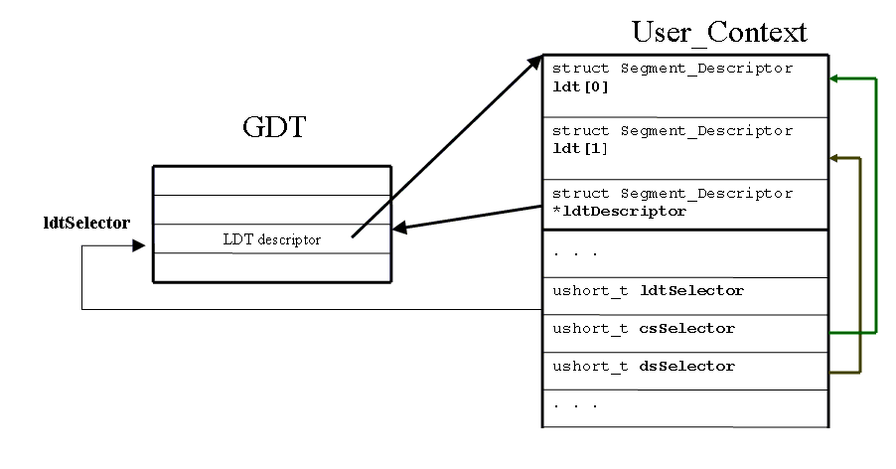
User process
Create_User_Context()
User_Context 메모리 할당
Code, Data Segment 초기화
인자로 받은 Process size만큼
메모리를 할당
LDT, Code, Data Selector 설정
GDT에 Process의 LDT Descriptor를 할당
refCount를 0으로 설정하고
User_Context 구조체를 Return
GDT의 LDT Descriptor가 Process의 LDT를
참조하도록 초기화

Slide 16
User_Context
include/geekos/user.h
Fields
struct User_Context
ldt : code/data segment descriptor(LDT)
ldtDescriptor : LDT descriptor pointer
memory : process base address pointer
size : process memory size
ldtSelector : LDT selector
csSelector : code segment selector
dsSelector : data segment selector
entryAddr : 제어의 최초 시작지점
argBlockAddr : argument segment address
stackPointerAddr : stack segment address
refCount : 참조하는 thread 개수

Slide 17
사용되는 함수
User context, User process 메모리 할당 및 base address 지정
Malloc(size) : size만큼 메모리 할당
memset(s, c, n) : 메모리 초기화
LDT descriptor 할당 : gdt.h, gdt.c 참조
Allocate_Segment_Descriptor() : GDT로부터 LDT를 할당
LDT descriptor, Code/Data segment descriptor 초기화 : segment.h 참조
PAGE_SIZE : 한 page의 크기
Init_LDT_Descriptor(*LDTdesc, LDT[], numEntries) : LDT와 LDT의 entry 개수를 참조하여 LDTdesc를 초기화
Init_Code_Segment_Descriptor(*desc, baseAddr, numPages, privilegeLevel) : process의 base address 및 page 개수를 참조하여 code segment descriptor 초기화
Init_Data_Segment_Descriptor(*desc, baseAddr, numPages, privilegeLevel) : process의 base address 및 page 개수를 참조하여 data segment descriptor 초기화
LDT Selector, Code/Data selector 지정
Selector(rpl, segmentIsInGDT, index) : rpl=privilege level, segment가 GDT에 있는지 여부, segment index
Get_Descriptor_Index(*desc) : GDT에서 LDT descriptor의 index를 확인

Slide 18
Definitions
include/geekos/defs.h
#define KERNEL_PRIVILEGE 0
#define USER_PRIVILEGE 3
#define PAGE_POWER 12
#define PAGE_SIZE (1<<PAGE_POWER)
#define PAGE_MASK (~(0xffffffff << PAGE_POWER))
include/geekos/user.h
#define NUM_USER_LDT_ENTRIES 2

Slide 19
Load_User_Program
You need to do:
create an LDT for the process
add a descriptor to the GDT that describes the location of the LDT
create a selector that contains the location of the LDT descriptor within the GDT
create descriptors for the code and data segments of the user program and add these descriptors to the LDT
create selectors that contain the locations of the two descriptors within the LDT
create a User_Context structure and store in it all of the information that will be needed to setup and run the user thread.
Notes
Only two segments for each user program: code and data
Other segments are in data segment.
Base of the code segment will be at the beginning of the executable image.

Slide 20
Start_User_Thread
수행 동작
creates a new thread
initializes the stack (Setup_User_Thread) : 구현되어 있음
makes the thread runnable, so that it will be scheduled and run
구현되어 있음

Slide 21
Initial stack state
Setup_User_Thread
Stack Data Selector (data selector)
Stack Pointer (end of data memory)
Eflags
Text Selector (code selector)
Program Counter (entry addr)
Error Code (0)
Interrupt Number (0)
General Purpose Registers
Ds (data selector)
Es (data selector)
Fs (data selector)
Gs (data selector)
Function Push in kthread.c can be used to push values.
See the codes for kernel threads.
Stack growth

Slide 22
Context switching
Preempt될 프로세스의 LDT
UserContext의 ldtSelector에 보관됨
수행시킬 새로운 프로세스의 LDT 복구
in function Switch_To_Address_Space (userseg.c)
/* Switch to the LDT of the new user context */
ldtSelector = userContext->ldtSelector;
__asm__ __volatile__("lldt %0"::"a"(ldtSelector) );
구현되어 있음

Slide 23
중간 테스트
Test
Try loading null.exe which makes Sys_Null system call.
System calls are defined in syscall.c, where Sys_Null is implemented already.
Stored as /c/null.exe

Slide 24
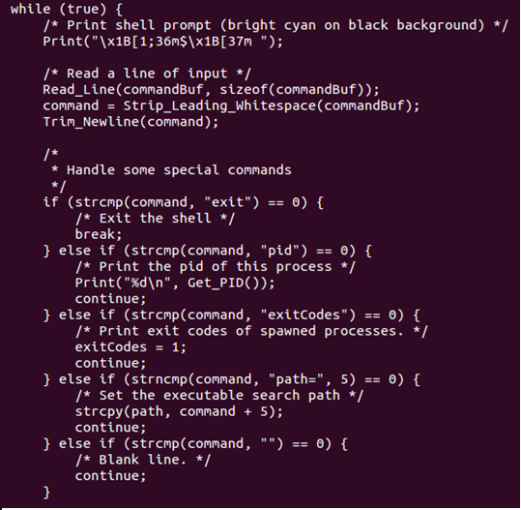
Shell program
// other stuff..

Slide 25
System calls
syscall.c
Syscall g_syscallTable[] : 시스템 호출 등록 테이블
Sys_Null
Do nothing
Sys_GetKey
Read a key from keyboard
Sys_PrintString
Straightforward - just do Print(“%s”,…);
Sys_Spawn
Start_User_Thread
Sys_Exit
Free_Segment_Descriptor
Free userContext->program
Free userContext
Call Exit in kthread.c
Sys_Wait
Join() in kthread.c

Slide 26
Background process
Attach “&” at the end of the command.
The program is spawned as a background process.
You don’t Wait() for the process.
“&” is not passed to Spawn.

Slide 27
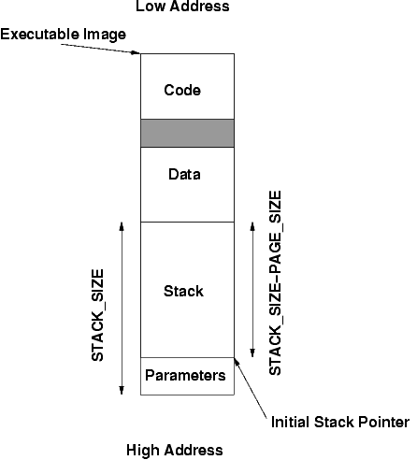
Passing parameters

Slide 28
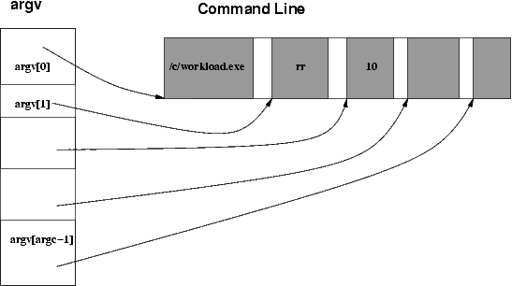
Passing parameters
_Entry function will call main(argc, argv)
Hint: 구현되어 있음.

Slide 29
제출 & 평가
소스코드
제출코드 : userseg.c
평가 : 총 30점

Slide 30


구현 테스트
기본 테스트 (15점) shell.exe는 수행하지 못하나, null.exe 가 수행되는 경우
shell 수행 (10점) shell 이 수행되어 명령을 입력받아 수행이 가능
< Test case >
입력: aa ➔ 출력: Could not spawn process: No such file or directory
입력: 엔터키 ➔ 출력: 다음 줄에 프롬프트 출력
3. 입력: /c/c.exe ➔ 출력:
4. 입력: exit ➔ 프로그램 종료
안되는 경우 -3점
안되는 경우 -3점
안되는 경우 -3점
프로세스 번호는 다를 수 있음
안되는 경우 -1점

Slide 31
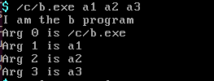

구현 테스트
3. Argument passing test (4점) At the shell prompt, typing: /c/b.exe arg1 arg2 … argn
Should output:
I am the b program
Arg 0 is /c/b.exe
Arg 1 is arg1
…
Arg n is argn
4. Background process (1점) At the shell prompt, typing: /c/long.exe &
should return the shell prompt immediately
and long.exe should run in the background.

Slide 32
구현테스트
오류의 감점
Crash : -10점
수행 오류 : 오류 당 -2점

